Slide 1
Machine Learning in Healthcare
Predict the chances of survival of a patient after 1 year of treatment
Submitted By: Tushar Agrawal 1900910130119
Group Mentor: Mr. Ajay Indoria

Slide 2
Introduction
The symptomatology affecting us is hyper-variable. Current practice guidelines, the variability of experience in medicine, the translatability and two-way outcome tracking suffers. This can lead to sub-optimal handling of the disease. Patient outcome is unpredictable.
In ‘Machine Learning’, machine is made to learn the various parameters including, symptoms, behavior, biochemical and pathologic variables, among others. With help of a specially-designed software, the computer can develop effective learning.
Algorithms are made used to:
Improve accuracy of diagnosis and risk prediction
Automate detection of relevant findings
Reduce medication errors and adverse events
And many more…

Slide 3
Motivation
Opportunity to contribute to the society by making use of technology
AI has found its major application in the healthcare sector. Its applications range from some simple problems to some very complex ones like cancer detection.
It is crucial that a patient gets personalized and accurate treatment based on his/her medical history for maximum benefits and positive results.
Using machine learning, we can determine whether the prescribed treatment will work for some patients or not and ensure that patient gets correct treatment.
Algorithms can be made to produce highly accurate results and eliminate the errors that humans may make.

Slide 4
Objective
Improve care conditions of hospitals by looking at historic survival of the patients.
Look at the data and identify the main factors leading to high survivals.
Develop a model that will predict the chances of survival of a patient after 1 year of treatment.
The dataset contains the patient records collected from a hospital in Greenland.
Ensure that maximum patients get benefits and their chances of survival increase.

Slide 5
Dataset & Data Description
Data can be loaded from: https://raw.githubusercontent.com/dphi-official/Datasets/master/pharma_data/Training_set_begs.csv
The “Survived_1_year” column is a target variable which has binary entries (0 or 1).
Survived_1_year == 0, implies that the patient did not survive after 1 year of treatment
Survived_1_year == 1, implies that the patient survived after 1 year of treatment
Data Description:
ID_Patient_Care_Situation: Care situation of a patient during treatment
Diagnosed_Condition: The diagnosed condition of the patient
ID_Patient: Patient identifier number
Treatment_with_drugs: Class of drugs used during treatment

Slide 6
Dataset & Data Description
Data Description:
Patient_Age: Age of the patient
Patient_Body_Mass_Index: A calculated value based on the patient’s weight, height, etc.
Patient_Smoker: If the patient was a smoker or not
Patient_Rural_Urban: If the patient stayed in Rural or Urban part of the country
Previous_Condition: Condition of the patient before the start of the treatment ( This variable is splitted into 8 columns - A, B, C, D, E, F, Z and Number_of_prev_cond. A, B, C, D, E, F and Z are the previous conditions of the patient. Suppose for one patient, if the entry in column A is 1, it means that the previous condition of the patient was A. If the patient didn’t have that condition, it is 0 and same for other conditions. The column Number_of_prev_cond will have entry as 2 i.e. 1 + 0 + 1 + 0 + 0 + 0 + 0 + 0 = 2 in this case.)

Slide 7
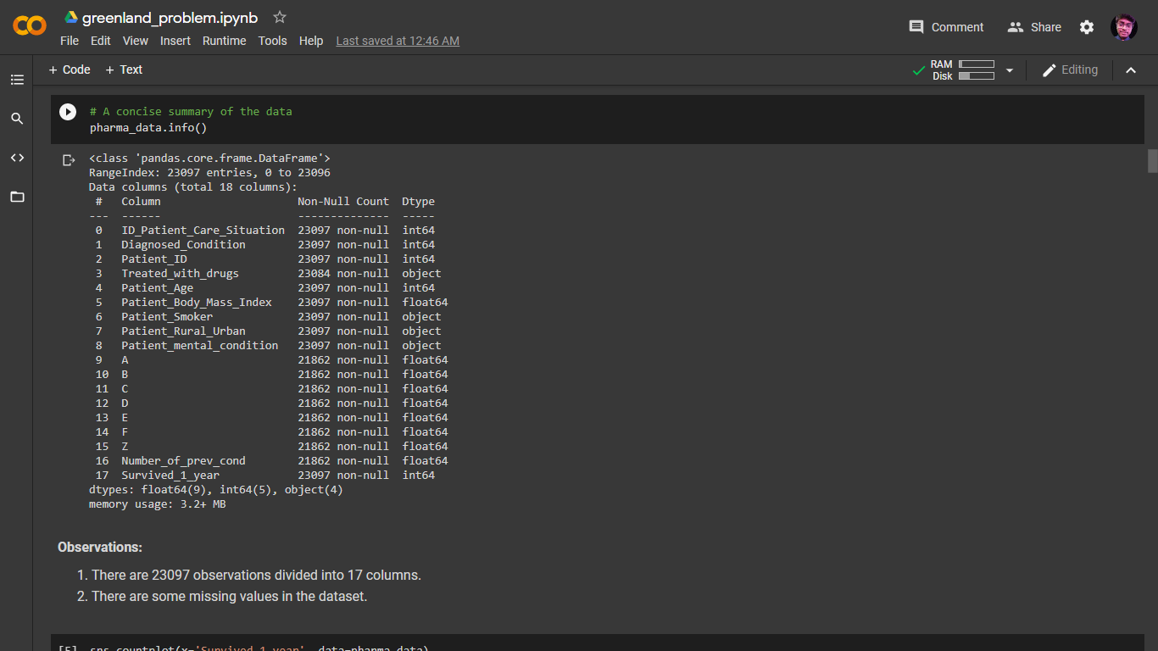
Dataset & Data Description

Slide 8
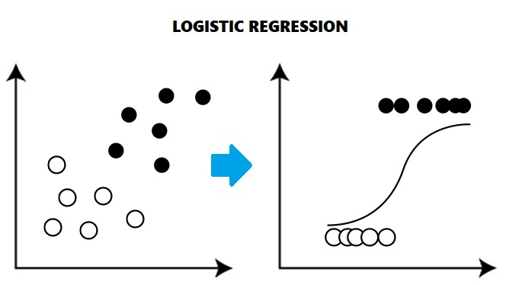
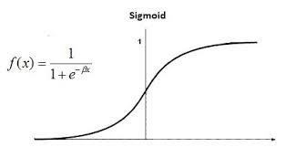
Logistic Regression
Assumes data is almost /perfectly linearly separable.
Can pick up most important features using weight vectors.
O(nd) and O(d) – Train and run time, used at scale classification.
Plane or hyperplane decision surface
Numerical features must be standardized
Less impact of outliers due to squashing of the sigmoid function.

Slide 9
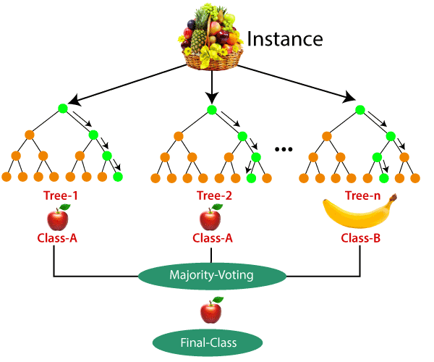
Random Forest (Majority Wins)
Handles Missing Data
Handles Redundancy
Reduces Variations in results
Produces out of bag error rate
Produces De-correlated Trees
Random subspace and split

Slide 10
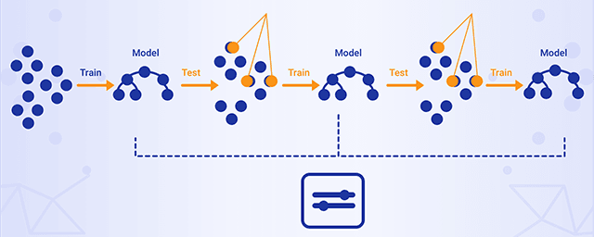
Gradient Boosting (Iterative Corrections)
Learning from Past Mistakes
Could get nearly 0 training error.
Weighted Scoring of multiple trees
Identifies difficult observations by large residuals computed in previous iterations.
“Shortcomings” are identified by gradients
Further dissects error components to bring in more explanation

Slide 11
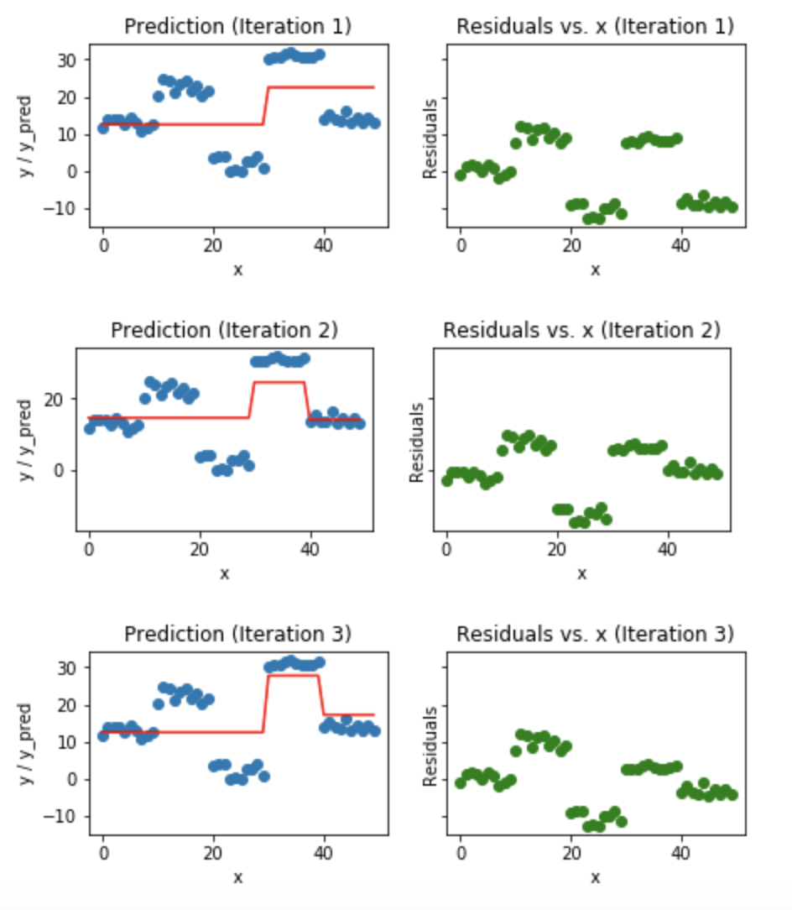
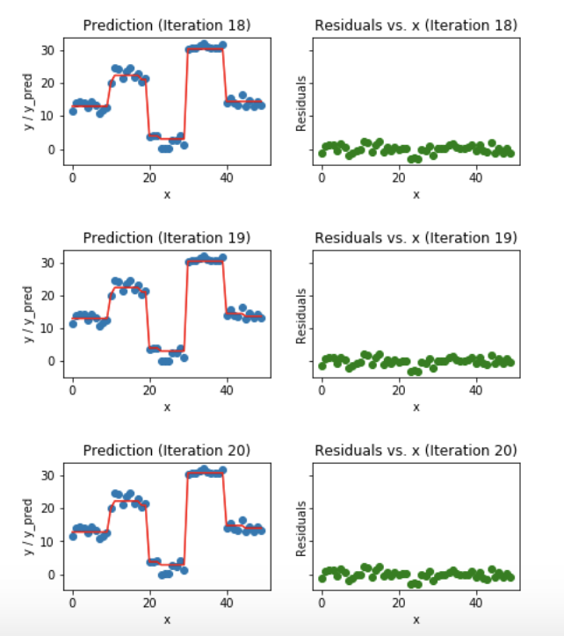
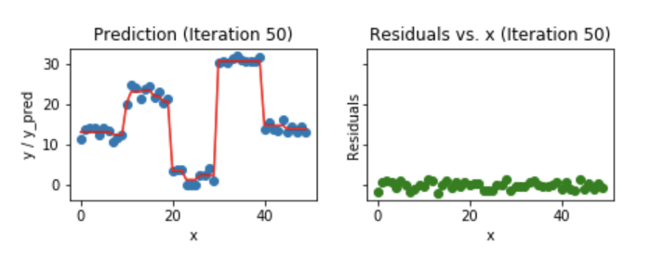
Gradient Boosting (Iterative Corrections)

Slide 12


Performance Estimation – F1 Score
F1 Score:
Can be interpreted as a weighted average of the precision and recall
Reaches its best value at 1 and worst score at 0.
Seek a balance between Precision and Recall.
Better measure of the incorrectly classified cases

Slide 13
Results
Project Link: https://colab.research.google.com/drive/1L0MqWMfS3RZCWW7FhWm3NdhffszcyEyZ?usp=sharing
Out of Logistic Regression, Random Forest, and Gradient Boosting, the maximum performance was achieved for Gradient Boosting Classifier Model.
F1 – Scores of models employed:
Logistic Regression: 0.749
Random Forest: 0.849
Gradient Boosting: 0.862
F1-score increased from 0.862 to 0.8829 after hyperparameter tuning.
We are able to predict whether a patient will survive or not after 1 year of treatment on feeding his/her medical reports in the model.

Slide 14
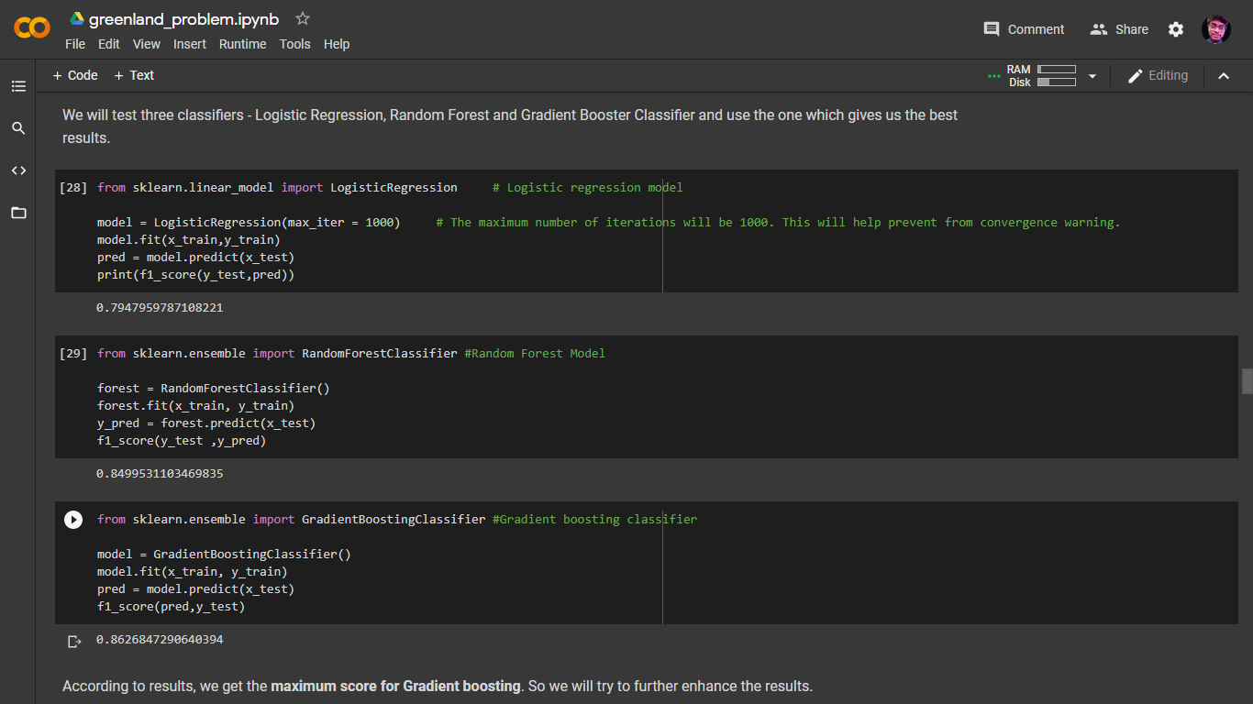
Results

Slide 15
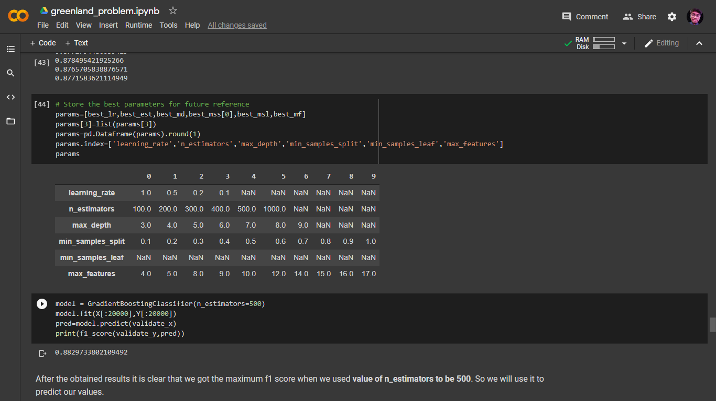
Results

Slide 16
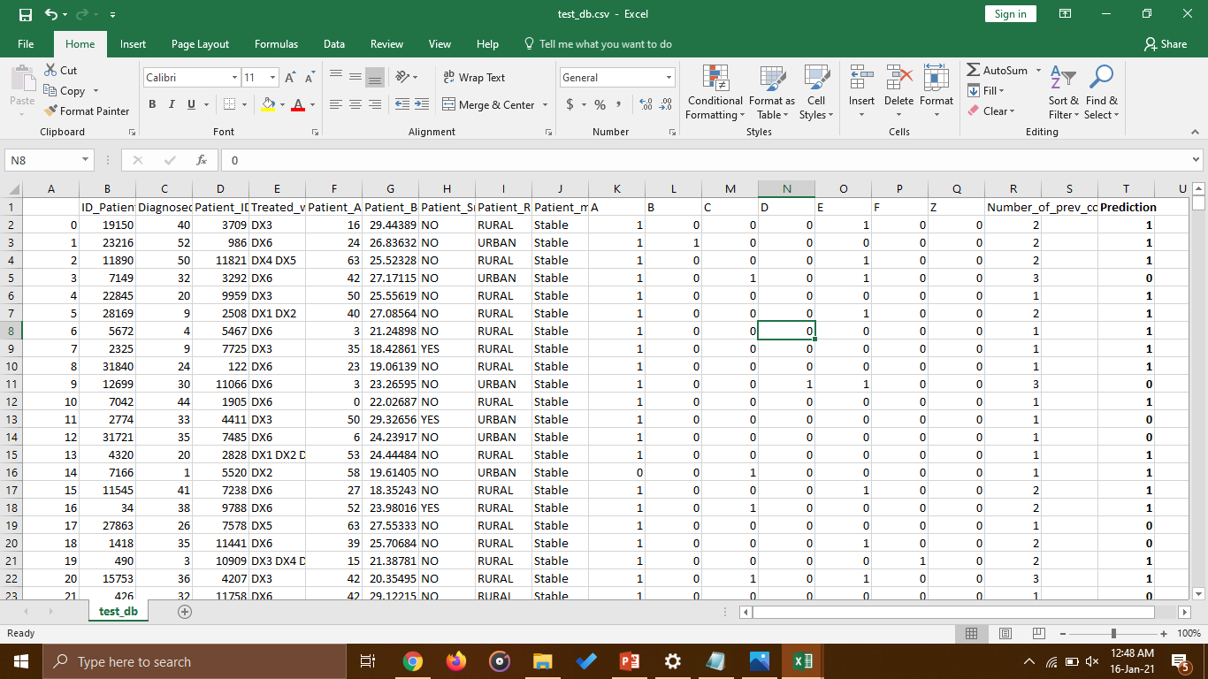
Results

Slide 17
Scope
Even though we are able to achieve our objective with a considerably good performance, there is always scope for improvement.
This is just one of the many possible ways to tackle the problem. Even better algorithms and techniques can be made to use to achieve higher performances.
Use of personal computers was made to demonstrate a solution for the problem which has hardware limitations. In the real-world scenarios, high-end machines can be used for achieving even better performances.
There is a limit on publicly available hospital data which further limits the performance of model. Better models, using larger sets of data, can be made at large organizations.
AI being a field with never stopping advancements, we can incorporate advanced algorithms for better results.

Slide 18
Related Work - Treatment and prediction of disease
PROGNOS
Location: New York, New York
How it’s using machine learning in healthcare: The company claims its Prognos Registry contains 19 billion records for 185 million patients. With an assist from machine learning, Prognos’s AI platform facilitates early disease detection, pinpoints therapy requirements, highlights opportunities for clinical trials, notes gaps in care and other factors for a number of conditions.
Industry impact: Last year Prognos reportedly raised $20.5 million in a Series C funding round. The backing came from insurance companies, drug manufacturers and venture capitalists.

Slide 19
Related Work – Smart Records
KENSCI
Location: Seattle, Washington
How it’s using machine learning in healthcare: KenSci uses machine learning to predict illness and treatment to help physicians and payers intervene earlier, predict population health risk by identifying patterns and surfacing high risk markers and model disease progression and more.
Industry impact: KenSci recently partnered with healthcare consulting firm T3K Health to focus on helping caregivers harness AI and machine learning for health records and workflow.

Slide 20
Related Work - Medical imaging and diagnostics
PATHAI
Location: Cambridge, Massachusetts
How it’s using machine learning in healthcare: PathAI’s technology employs machine learning to help pathologists make quicker and more accurate diagnoses as well as identify patients that might benefit from new types of treatments or therapies.
Industry impact: In 2017 the company raised an additional $11 million in a Series A funding round, which brought its total bank to $15 million.

Slide 21
Technical Feasibility
Programming Language Used:
Python
Software Used:
Google Colab
Hardware Used:
Google Colab’s Default Notebook Instance
Algorithms used:
Logistic Regression
Random Forest
Gradient Boosting Classification
Pre-Processing used:
sklearn’s StandardScaler()

Slide 22
Technical Feasibility
In most cases, treatment required, symptoms observed, suggested medications, and other similar factors depend upon geographical locations. It is required that data we use is achieved from all over the world to build some robust and generalized models to rely upon
In matter of life and death, we require great models to rely upon. Advanced AI techniques must be employed to achieve maximum performance.
To handle a large amount of data and robust models, equally powerful hardware, with all modern high-end specifications, is required.
AI models work efficiently when data is clean and organized. It is equally important that available data can be made to use directly or after some pre-processing.

Slide 23
References
[1] Friedman, J., Hastie, T., and Tibshirani, R. (2000). Special invited paper. additive logistic regression: A statistical view of boosting. Annals of statistics, pages 337-374.
[2] Friedman, J. H. (2001). Greedy function approximation: a gradient boosting machine. Annals of Statistics, pages 1189-1232.
[3] Schapire, R. E. and Freund, Y. (2012). Boosting: Foundations and Algorithms. MIT Press.
[4] James, Gareth, Daniela Witten, Trevor Hastie, and Robert Tibshirani. 2014. An Introduction to Statistical Learning: With Applications in R. Springer Publishing Company, Incorporated.
[5] Mintz Y, Brodie R. Introduction to artificial intelligence in medicine. Minim Invasive Ther Allied Technol. 2019;28:73–81. [PubMed] [Google Scholar]

Slide 24
References
[6] CB Insights Research. Healthcare remains the hottest AI category for deals. 2017. [Last accessed on 2018 Mar 24]. Available from: https://www.cbinsights.com/research/artificial-intelligence-healthcare-startups-investors/
[7] Hamlet P, Tremblay J. Artificial intelligence in medicine. Metabolism. 2017;69S:S36–40. [PubMed] [Google Scholar]
[8] Prince Grover, “Gradient Boosting from scratch”, Medium. [Online] Available: https://medium.com/mlreview/gradient-boosting-from-scratch-1e317ae4587d
[9] Purva Huilgol, “Accuracy vs. F1-Score”, Medium. [Online] Available: https://medium.com/analytics-vidhya/accuracy-vs-f1-score-6258237beca2

Slide 25
Thank You !!!

